Slide 1
MELBOURNE or SYDNEY

Slide 2
Problem Statement
The debate over whether Sydney is better than Melbourne is one Australian’s (especially from Melbourne/Sydney) love to debate
So which is better and on what dimensions?
Set out to explore both Melbourne & Sydney City councils to compare (probably unfair, both have amazing locations outside these boundaries)
Use foursquare venue data augmented with ABS statistics to segment/cluster neighborhoods to describe/explore each city
Combine and find like neighbourhoods
Compare limited set of cafes, bars and restaurants and their rating

Slide 3
Point of comparison: Sydney vs. Melbourne
Sydney city council comprises of 25 km² smaller than Melbourne city council at 37 km2 but still has more café’s then Melbourne. This could be because Melbournian’s love their coffee and prefer to call the venue a coffee shop? Not particularly conclusive.
Both cities have a large number of café’s, restaurants and bars of many varieties that indicate their cosmopolitan populations.
Sydney has a larger number of bars and pubs in the surrounding area in contradiction to Melbourne’s popular bar scene.
Sydney has a higher concentration within the city whereas Melbourne’s sprawling suburbs offer variety.

Slide 4
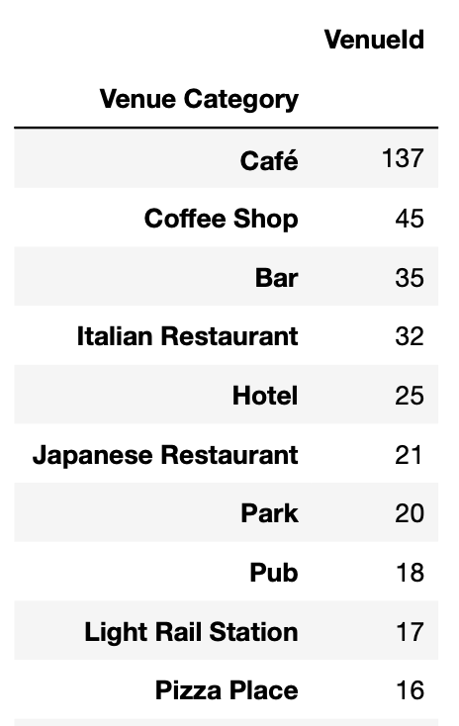
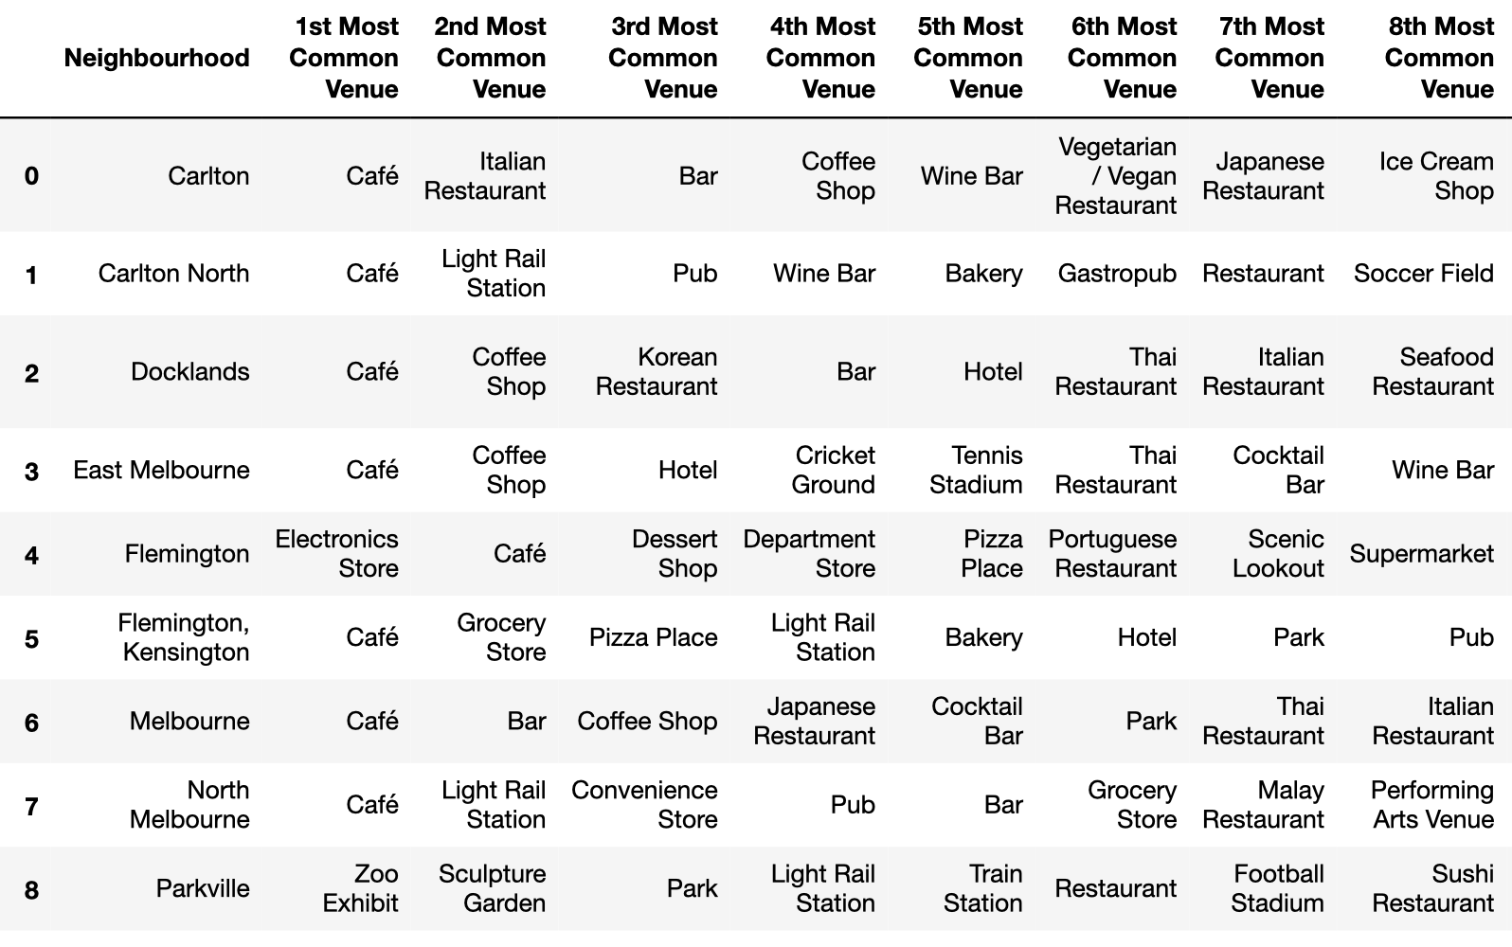
Venues (Melbourne)

Slide 5
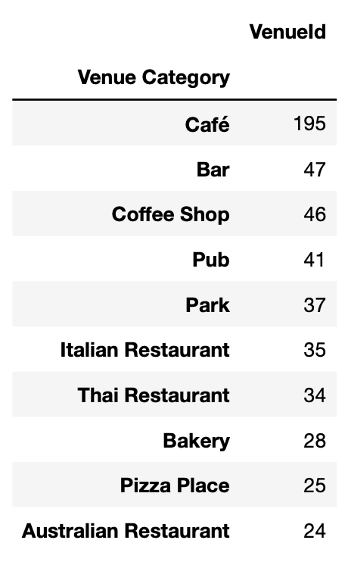
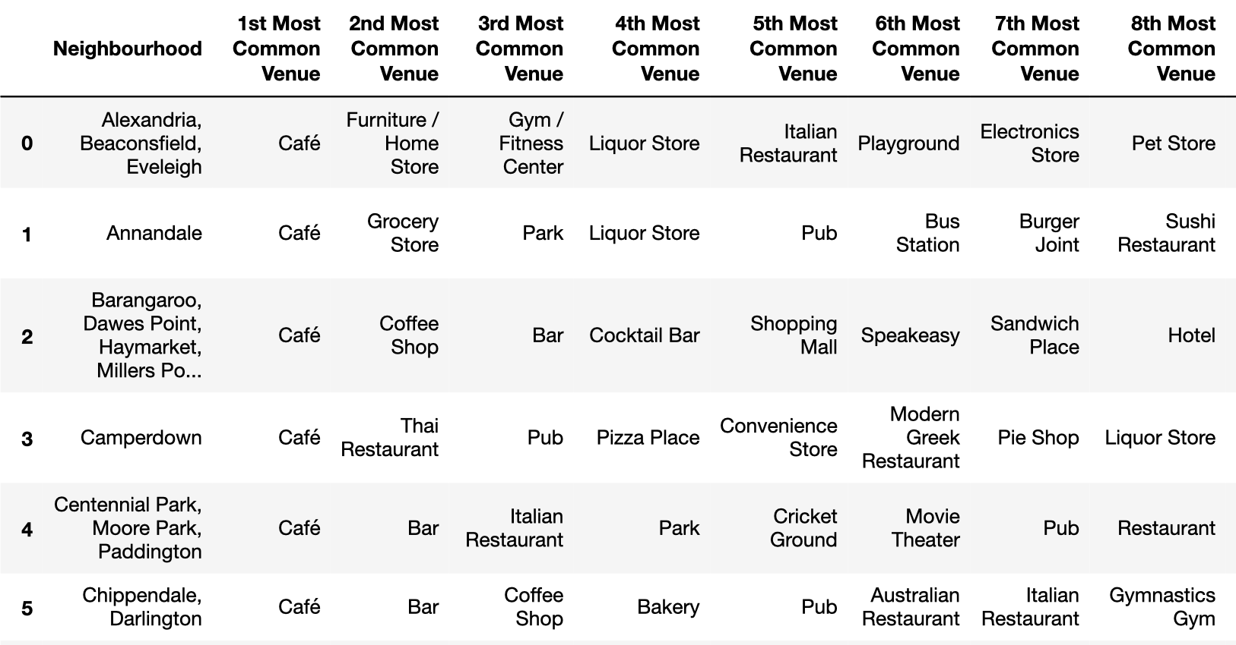
Venues (Sydney)

Slide 6
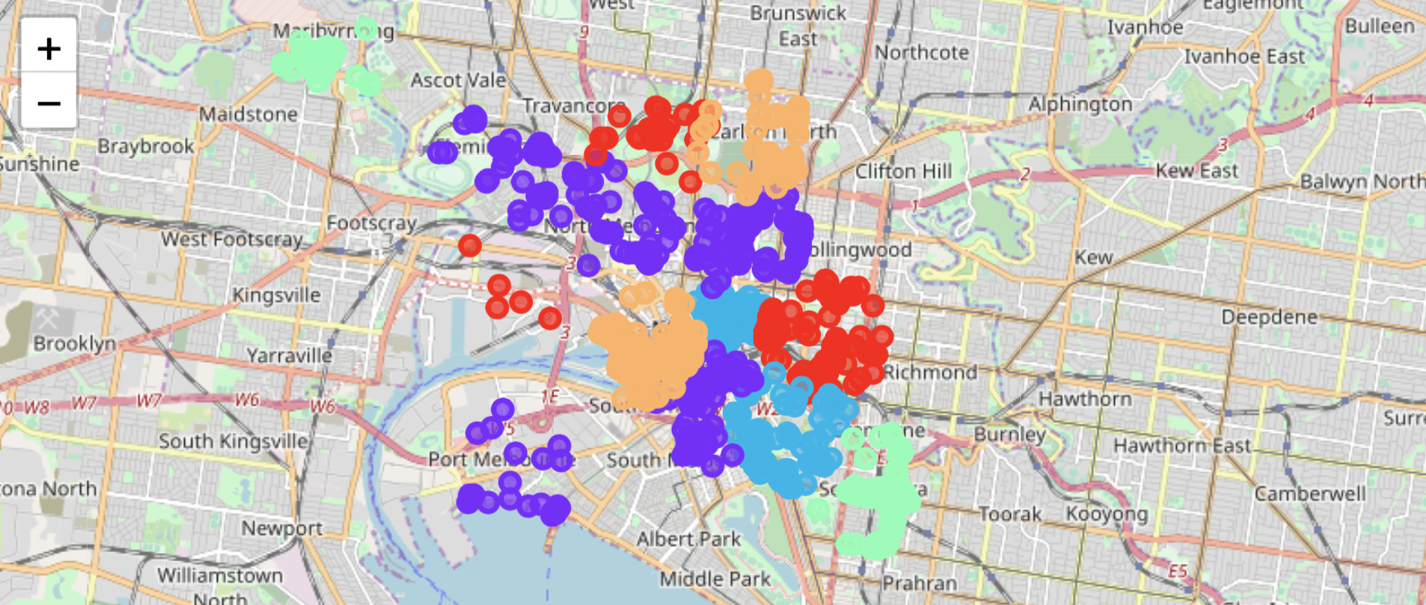
Neighbourhoods & Clusters/Segments
Melbourne

Slide 7
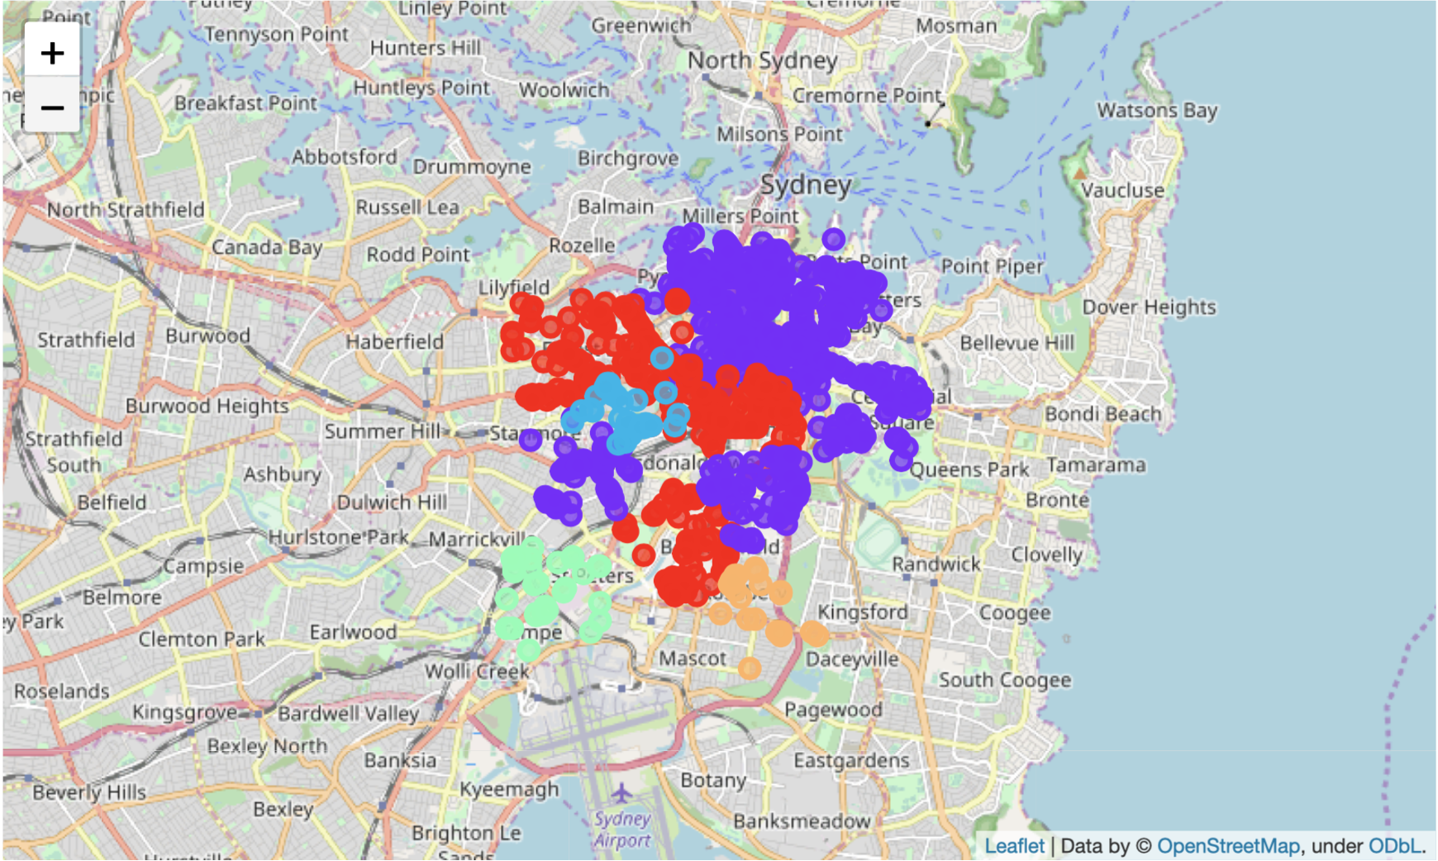
Neighbourhoods & Clusters/Segments
Sydney

Slide 8
Cafes
Not complete (wait an hour)

Slide 9
Bars
Not complete (wait an hour)

Slide 10
Restaurants
Not complete (wait an hour)

Slide 11
Summary
It is not possible to answer the question with the data provided.
Sydney appears to have more venues but less area, this leaves questions about whether the foursquare data is dense enough for both cities and maybe biased towards Sydney that receives more visitors (I’m from Melbourne of course!)
Both cities have similar suburbs but also significant variations (had to drop a lot of venue data to complete comparisons)
Melbourne’s bar/café scene is certainly not unique to Melbourne and Sydney have their own claims in this respect.
Further analysis of ratings is required.

Slide 12
Limitations, assumptions, excuses
Assumed that Sydney/Melbourne city council zones were appropriate for comparison. Both miss key parts that people would normally consider essential parts of each city, but had to limit the analysis in some way.
Foursquare venues listed in Australian seem somewhat limited, compared with the volume listed with google. Also, tourist volumes to each city may vary resulting in biases within each data set.
Google unfortunately limits venue search to 60 (over multiple pages)
I was able to manually move around the CBD (or part of to do a quick comparison but ultimately ran out of time to do more)
Would have been great to add some additional data from open data sources available. Ultimately this because a timely exercise of looking for data and thinking about how it could be used.
Probably need to provide some normalization of the neighbourhood statistics

